Slide 1
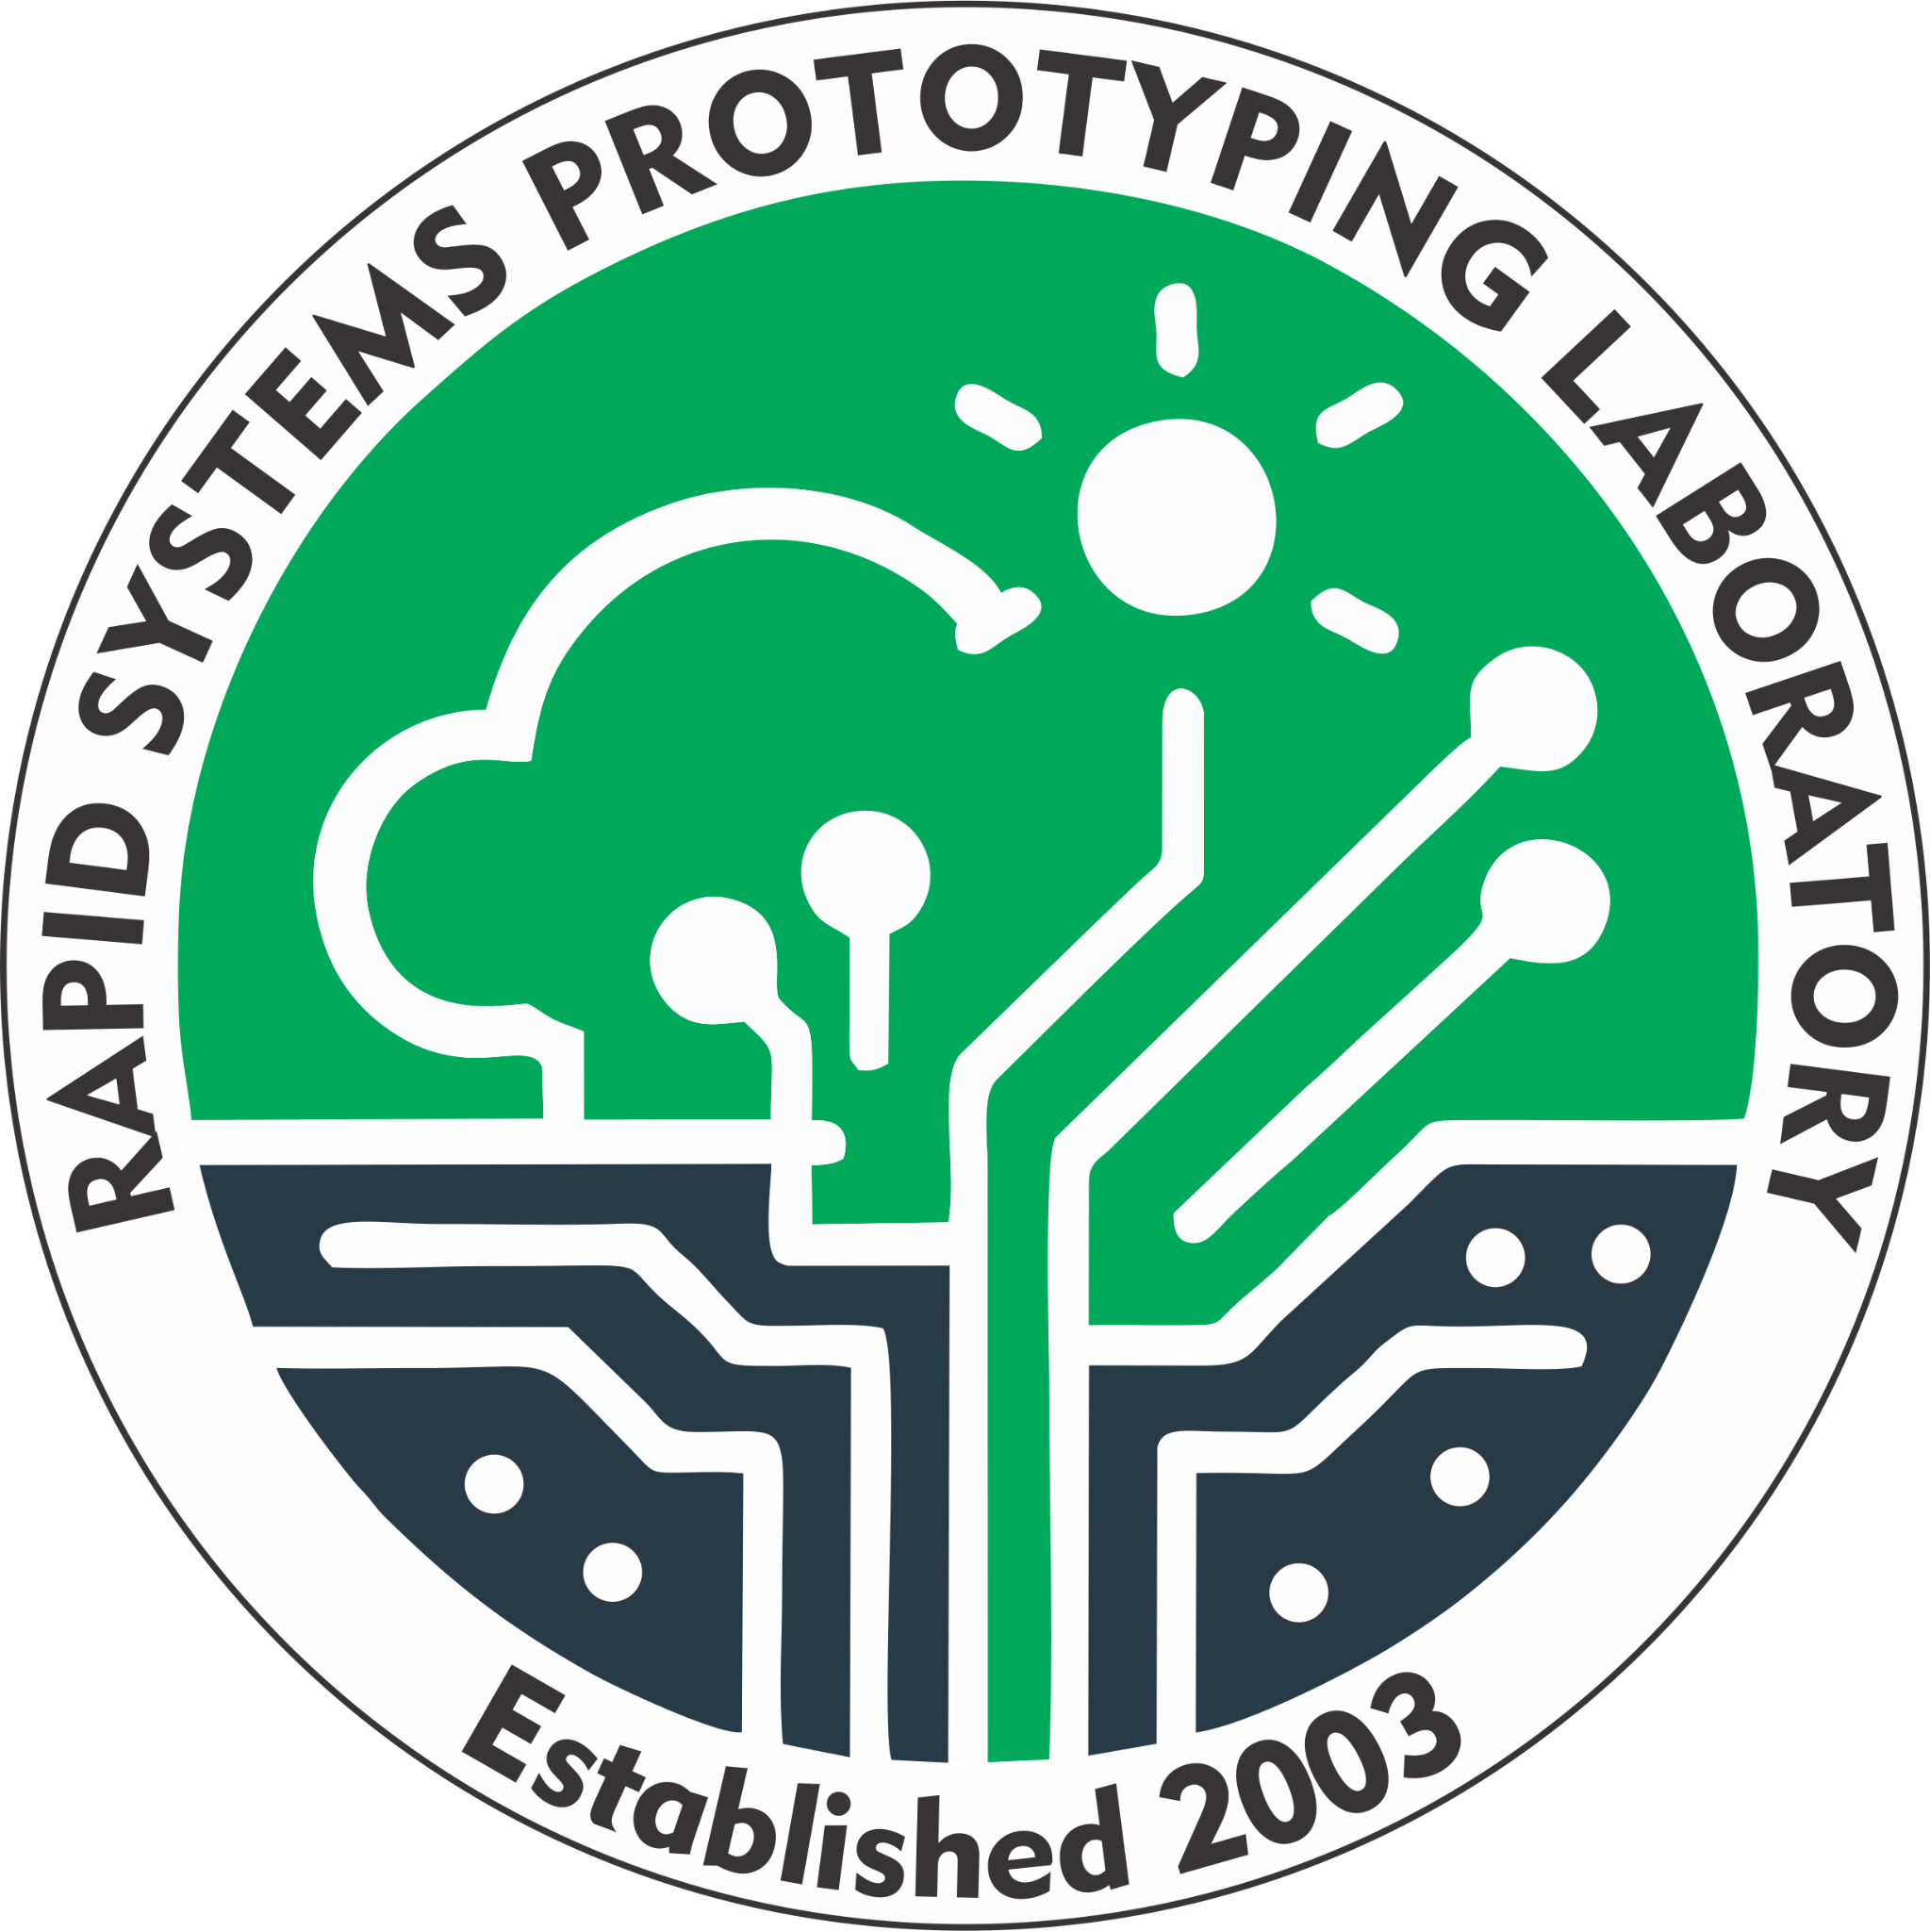

Using IoT Technologies to Monitor and Control Hydroponic Systems
Jonathan I. Rodríguez Guevárez and Kevin J Martes Cruz
Department of Electrical and Computer Engineering
University of Puerto Rico – Mayagüez
Tuesday April 30th, 2024
Advisor: Dr. Manuel Jiménez Cedeño Liaison: Jacob [Apellido]

Slide 2
OUTLINE
INTRODUCTION
PROBLEM DESCRIPTION
PREVIOUS WORK
OBJECTIVES
METHODOLOGY
METHODOLOGY
OVERVIEW OF SYSTEM
RESULTS
CONCLUSIONS
CONCLUSION
FUTURE WORK
REFERENCES
QUESTIONS
J. Rodriguez Guevárez, K. Martes Cruz : Using Iot Technologies To Monitor and Control Hydroponic Systems

Slide 3
INTRODUCTION

Slide 4
PROBLEM DESCRIPTION
Background:
Et ipsum
Challenge:
et ipsum
Project Goals:
Et ipsum
J. Rodriguez Guevárez, K. Martes Cruz : Using Iot Technologies To Monitor and Control Hydroponic Systems

Slide 5
PREVIOUS WORK
Work Done:
Et ipsum
J. Rodriguez Guevárez, K. Martes Cruz : Using Iot Technologies To Monitor and Control Hydroponic Systems

Slide 6
OBJECTIVES
Make a functional package that can be tested, replicated and made available for the public.
Have a functioning, interactive web application that is accessible through various platforms.
Et ipsum
Et ipsum
J. Rodriguez Guevárez, K. Martes Cruz : Using Iot Technologies To Monitor and Control Hydroponic Systems

Slide 7
METHODOLOGY

Slide 8
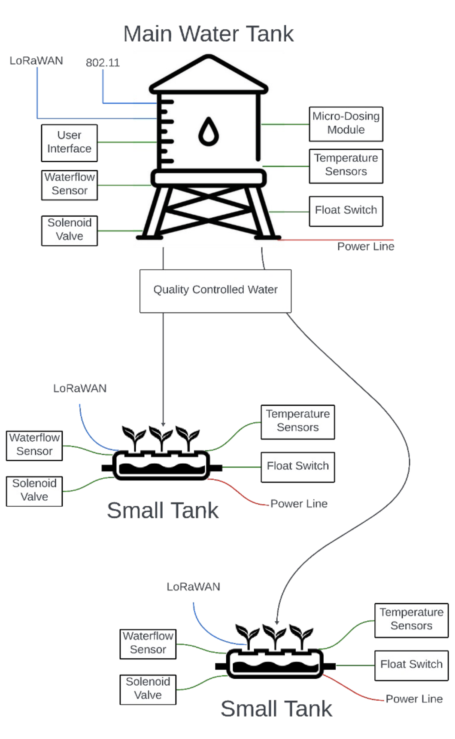
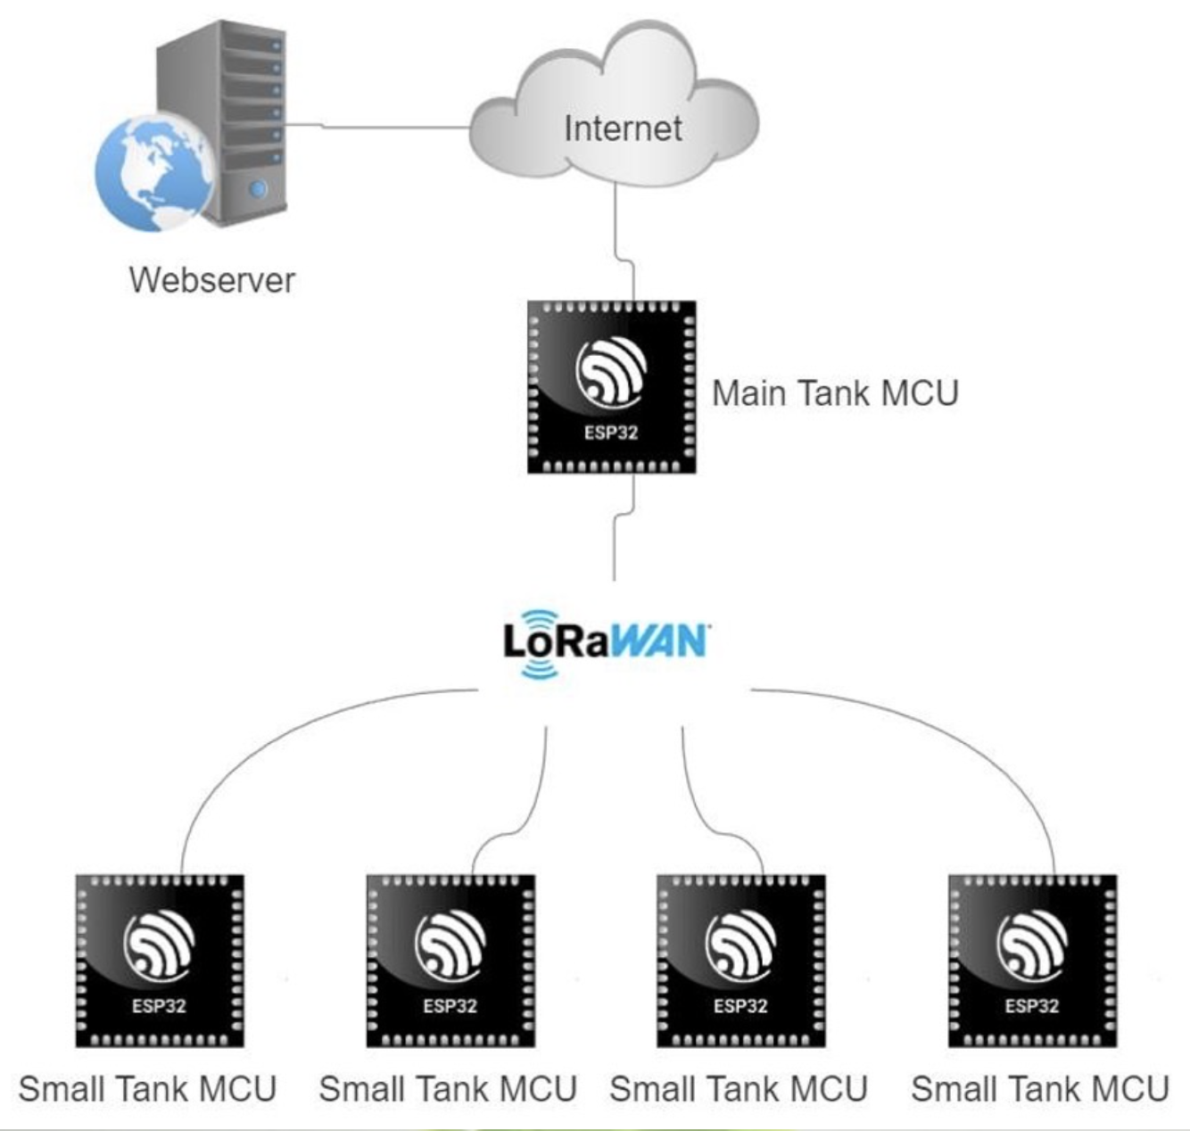
METHODOLOGY
Top Level:
J. Rodriguez Guevárez, K. Martes Cruz : Using Iot Technologies To Monitor and Control Hydroponic Systems

Slide 9
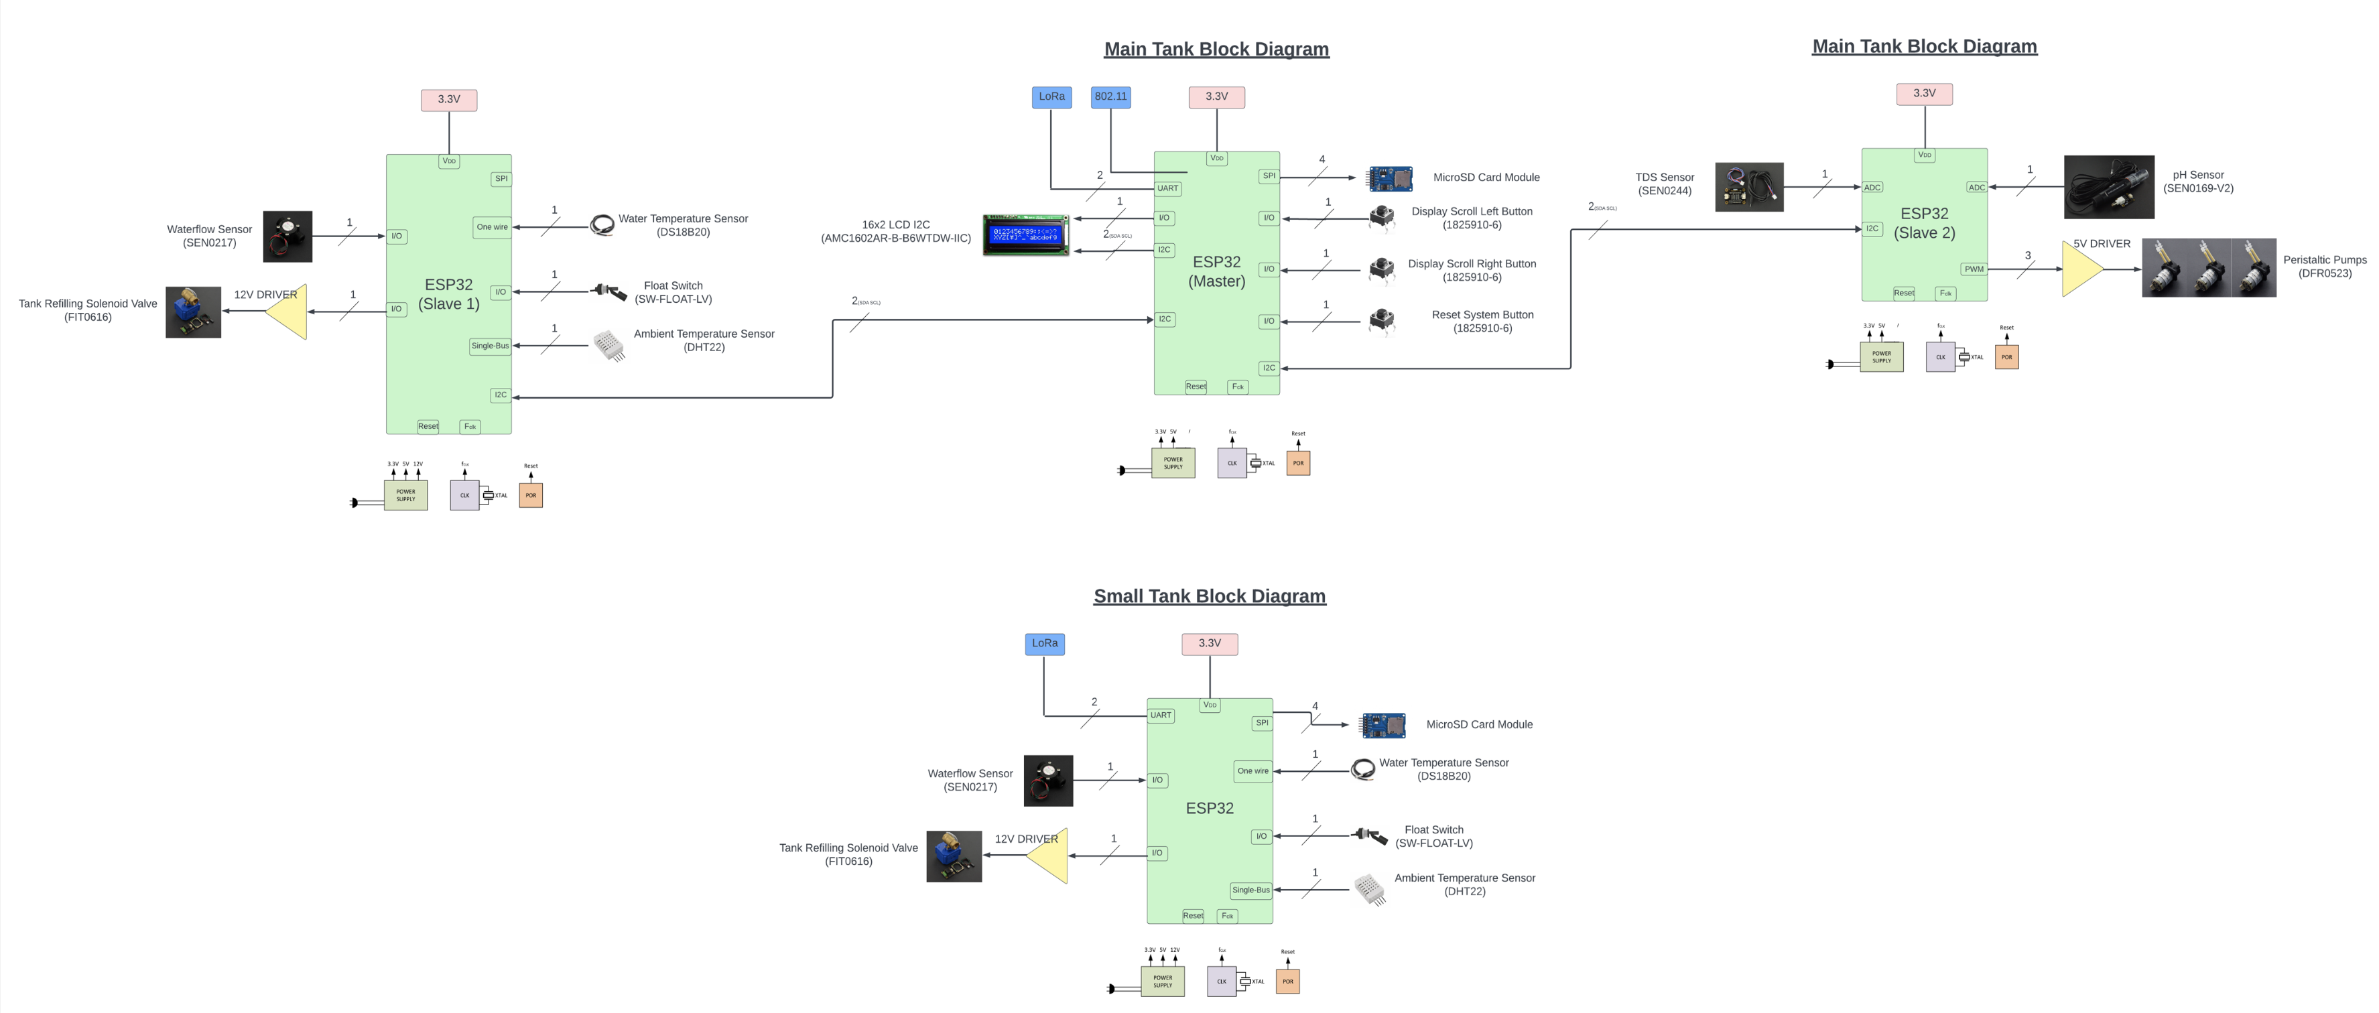
METHODOLOGY
System Architecture:
J. Rodriguez Guevárez, K. Martes Cruz : Using Iot Technologies To Monitor and Control Hydroponic Systems

Slide 10
METHODOLOGY
PCB Images
J. Rodriguez Guevárez, K. Martes Cruz : Using Iot Technologies To Monitor and Control Hydroponic Systems

Slide 11
METHODOLOGY
PCB Images
J. Rodriguez Guevárez, K. Martes Cruz : Using Iot Technologies To Monitor and Control Hydroponic Systems

Slide 12
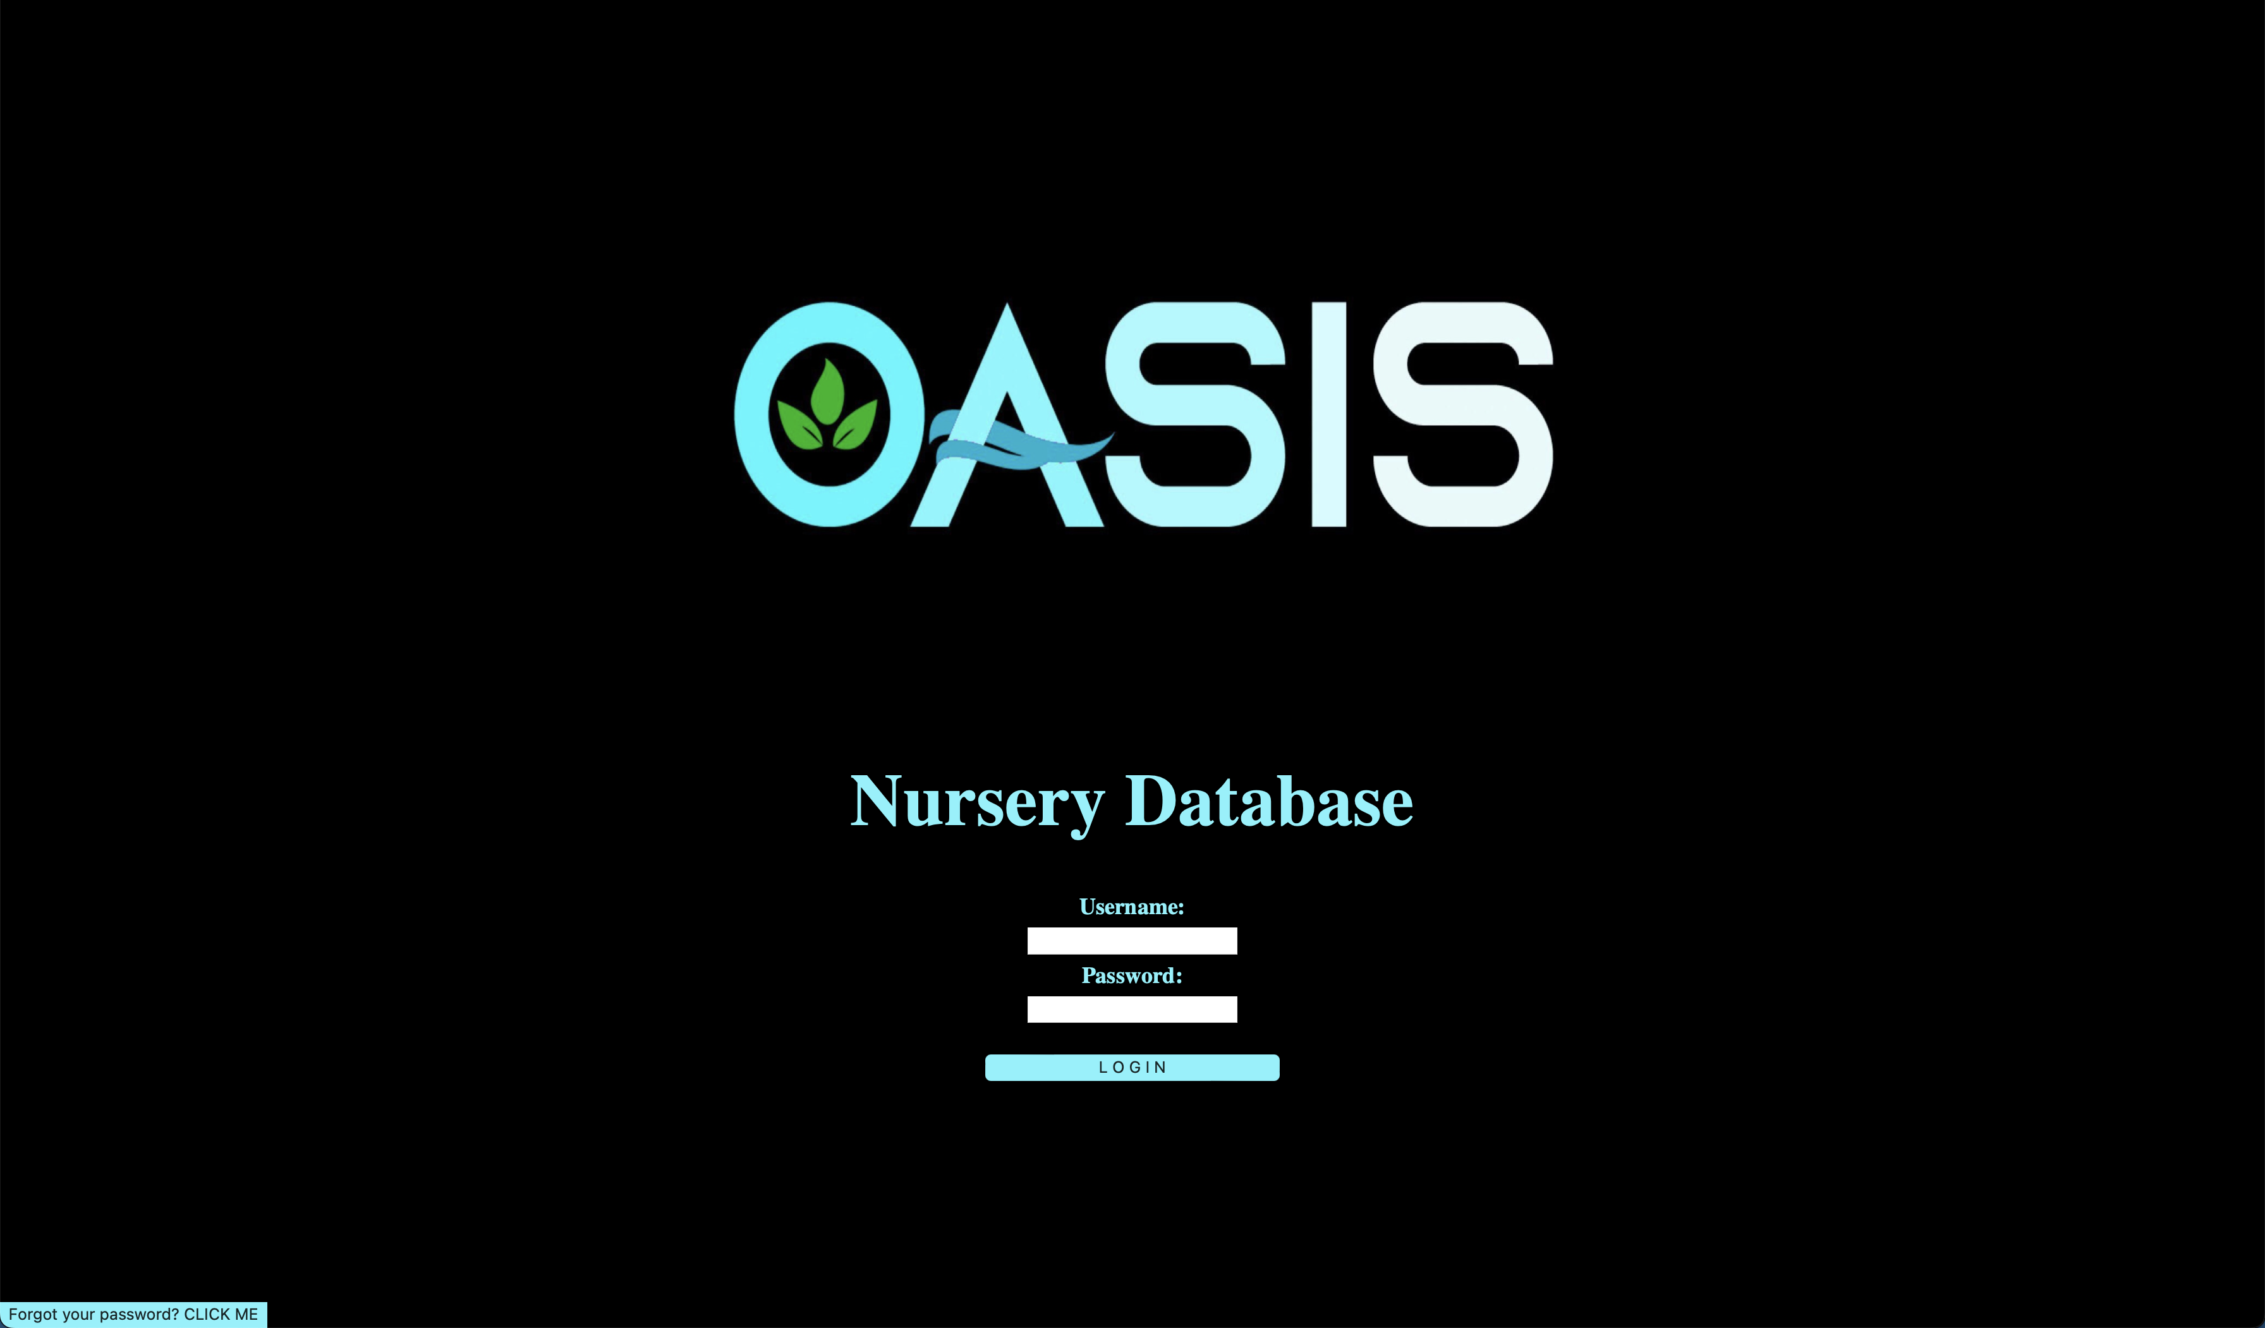
METHODOLOGY
Web App:
Figure x: Login Page
J. Rodriguez Guevárez, K. Martes Cruz : Using Iot Technologies To Monitor and Control Hydroponic Systems

Slide 13
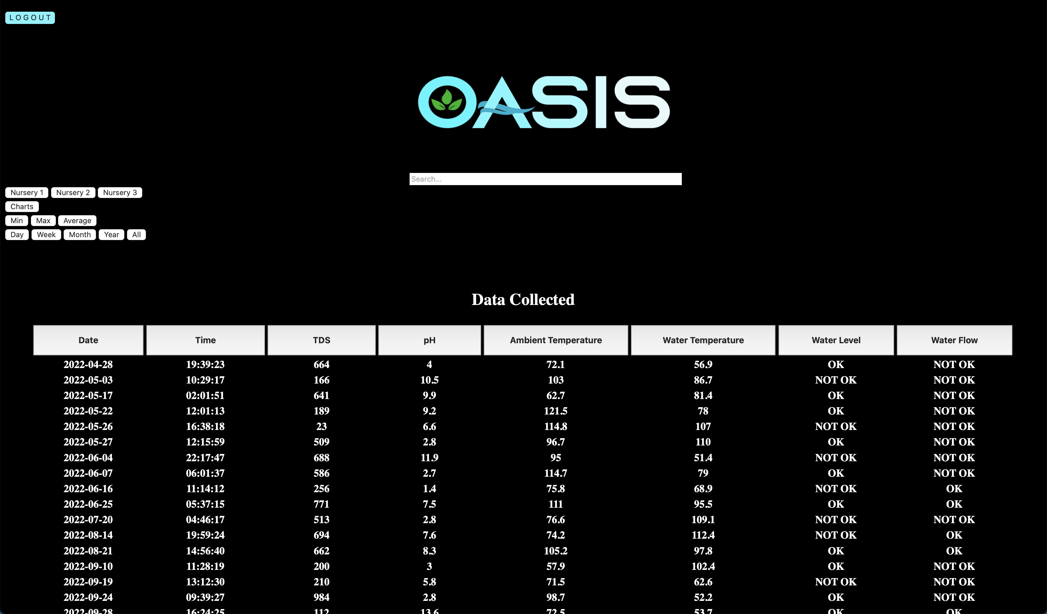
METHODOLOGY
Web App:
Figure x: Main Page
J. Rodriguez Guevárez, K. Martes Cruz : Using Iot Technologies To Monitor and Control Hydroponic Systems

Slide 14
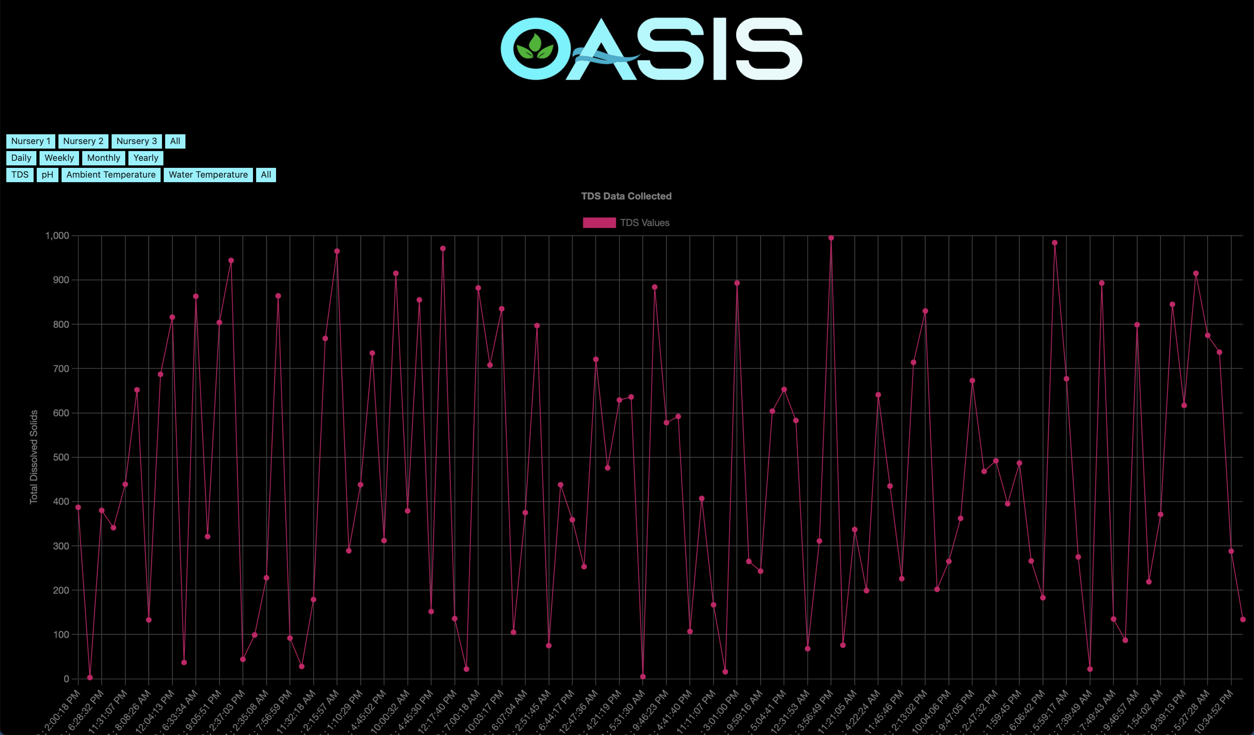
METHODOLOGY
Web App:
Figure x: Charts Page
J. Rodriguez Guevárez, K. Martes Cruz : Using Iot Technologies To Monitor and Control Hydroponic Systems

Slide 15
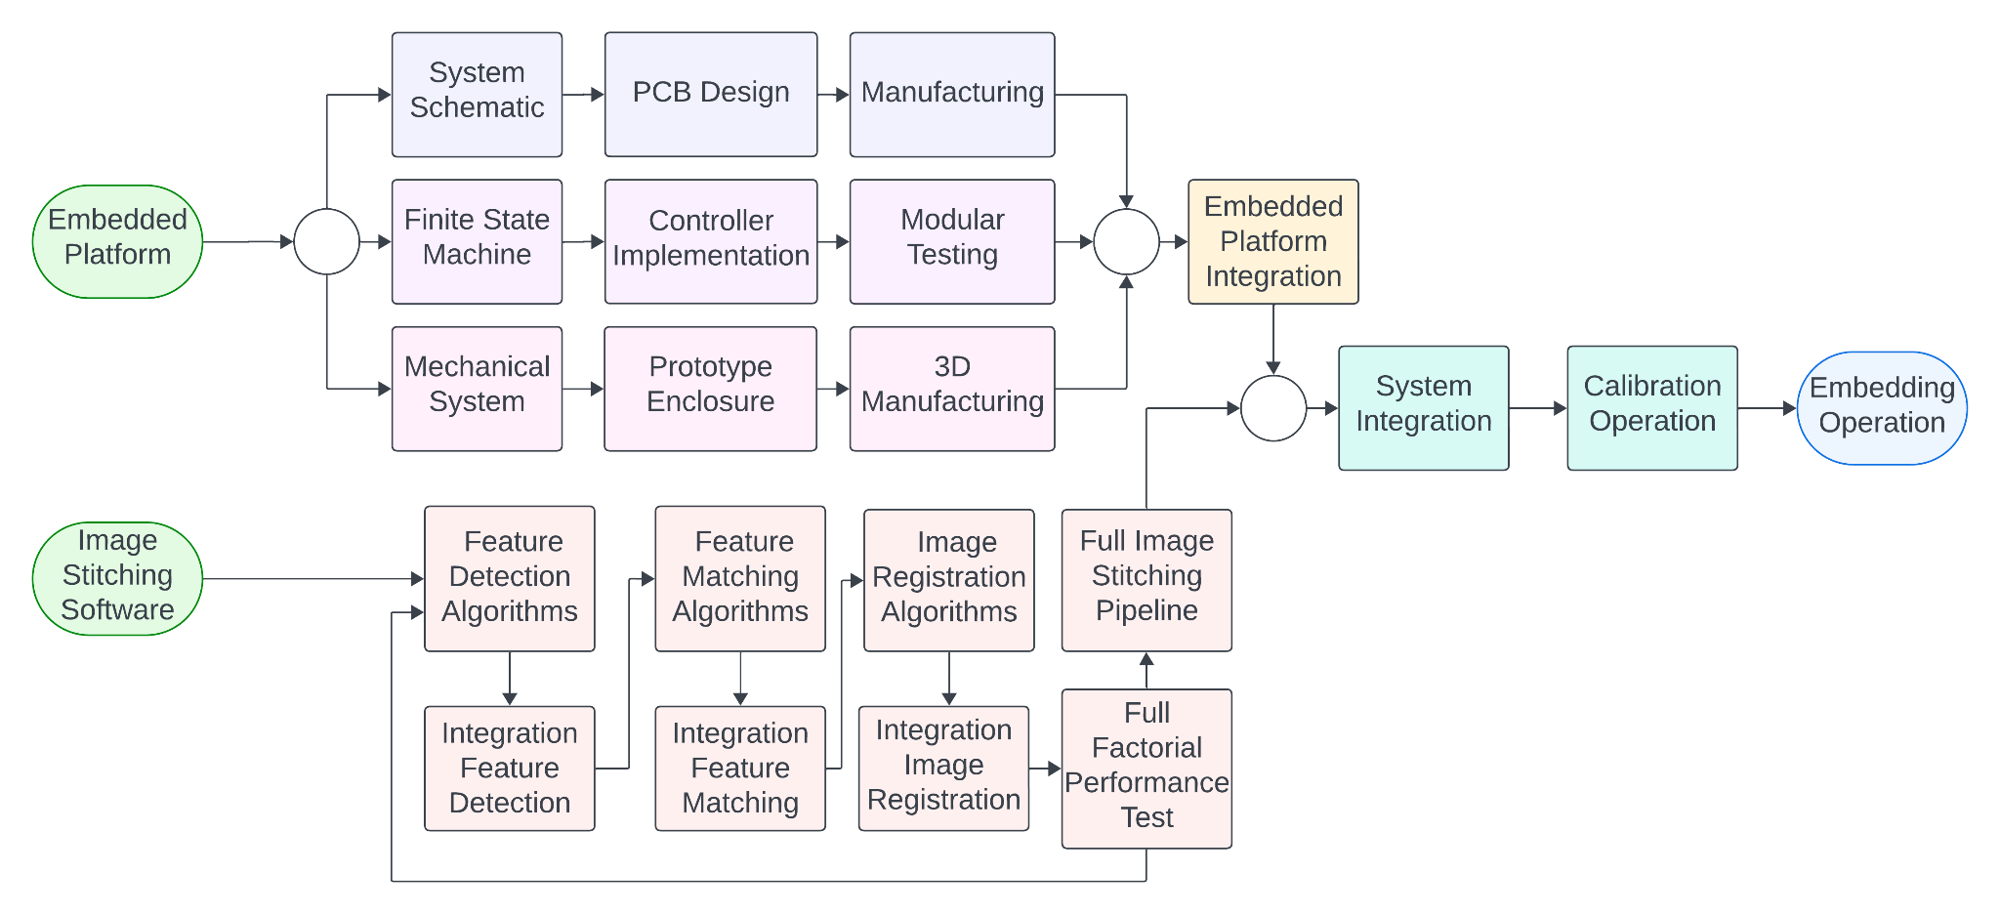
METHODOLOGY
Figure 2. Image Stitching System Cognitive Map
H. Rodríguez, A. Malpica, W. Muñiz, E. Camuy: Study of 4K Image Stitching Strategies for Efficient Embedded Implementation
Rapid Systems Prototyping Laboratory

Slide 16
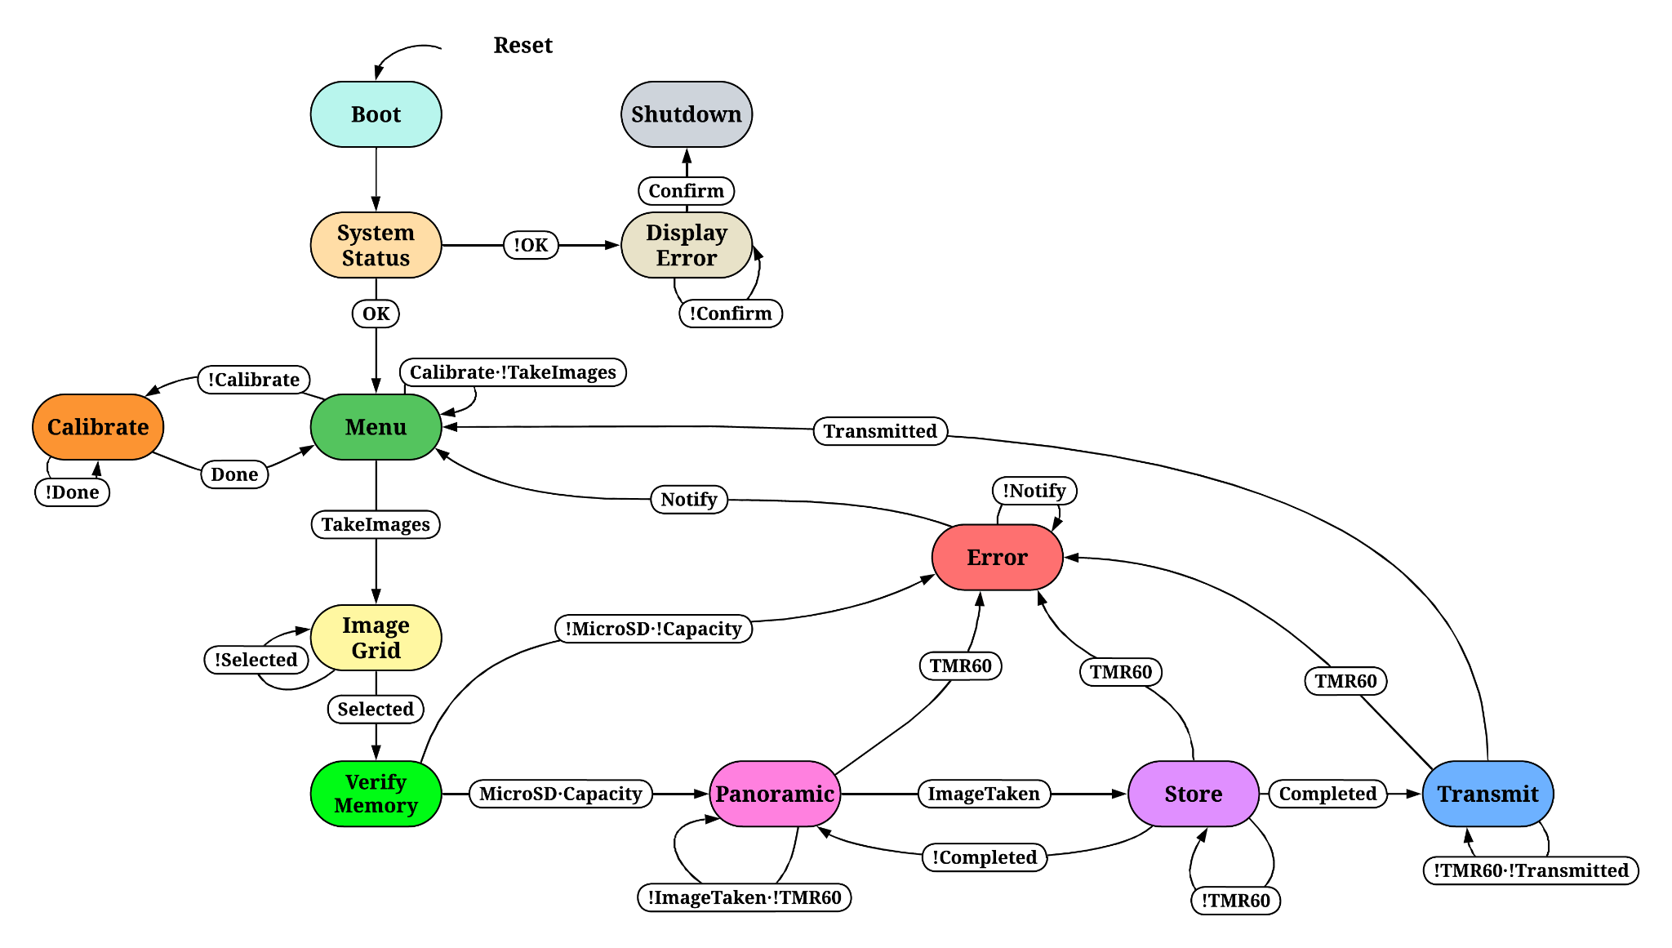
SYSTEM OPERATION
Figure 5. Finite State Machine Diagram
H. Rodríguez, A. Malpica, W. Muñiz, E. Camuy: Study of 4K Image Stitching Strategies for Efficient Embedded Implementation
Rapid Systems Prototyping Laboratory

Slide 17
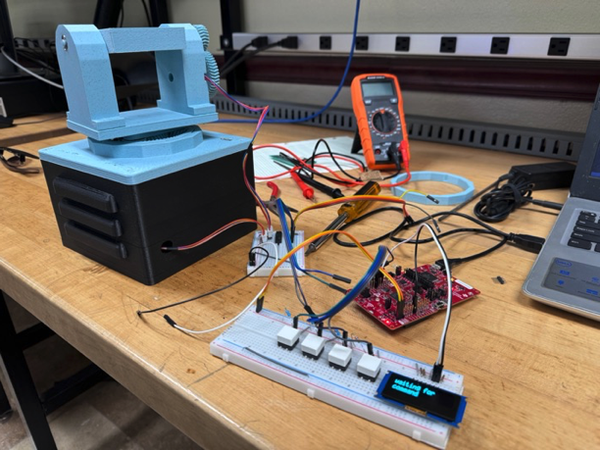
RESULTS | EMBEDDED PLATFORM
Manufacture completed with electronic and mechanical system alongside system enclosure.
Motor System can change elevation up to 90 degrees and azimuth rotation up to 360 degrees.
Image Capture with a resolution up to 2592x1944 and storage operation functionality.
Figure 18. Image Stitching Process Diagram
H. Rodríguez, A. Malpica, W. Muñiz, E. Camuy: Study of 4K Image Stitching Strategies for Efficient Embedded Implementation
Rapid Systems Prototyping Laboratory

Slide 18
CONCLUSIONS

Slide 19
CONCLUSION
After initial prototypes, PCB versions of the protoboards have been developed.
A working and pretty stable web-app has been developed.
Although used, we still have not proven the viability of using LoRaWAN technologies in our test environment.
J. Rodriguez Guevárez, K. Martes Cruz : Using Iot Technologies To Monitor and Control Hydroponic Systems

Slide 20
FUTURE WORK
More work will be needed to fully integrate and test the new PCB boards.
Sort out any changes that arise and improve on them based on level of importance.
Complete the functionality of all desired buttons and actions in the webapp.
Finish implementing some of the ideas the client desires.
Prove the viability of using LoRaWAN technologies in our test environment.
J. Rodriguez Guevárez, K. Martes Cruz : Using Iot Technologies To Monitor and Control Hydroponic Systems

Slide 21
FUTURE WORK
More work will be needed to fully integrate and test the new PCB boards.
Sort out any changes that arise and improve on them based on level of importance.
Complete the functionality of all desired buttons and actions in the webapp.
Finish implementing some of the ideas the client desires.
Prove the viability of using LoRaWAN technologies in our test environment.
J. Rodriguez Guevárez, K. Martes Cruz : Using Iot Technologies To Monitor and Control Hydroponic Systems

Slide 22
REFERENCES
J. Rodriguez Guevárez, K. Martes Cruz : Using Iot Technologies To Monitor and Control Hydroponic Systems

Slide 23
REFERENCES
N. Ibrahim and N. A. Wahab, "Developing and Evaluating a Virtual Tour Prototype Using Photo-Stitching Technique," 2010 Second International Conference on Computer Engineering and Applications, Bali, Indonesia, 2010, pp. 390-393, DOI: 10.1109/ICCEA.2010.82.
Hannuksela, Jari; Sangi, Pekka; Heikkila, Janne; Liu, Xu; Doermann, David (2007). "Document Image Mosaicing with Mobile Phones". 14th International Conference on Image Analysis and Processing (ICIAP 2007). pp. 575–582.
S. Suen; E. Lam; K. Wong (2007). "Photographic stitching with optimized object and color matching based on image derivatives". Optics Express. 15 (12): 7689–7696
A. Rosebrock, “Image Stitching with OpenCV and Python”, PYimageresearch, Available online at https://pyimagesearch.com/2018/12/17/image-stitching-with-opencv-and-python/
OpenCV Panorama Stitching, article available online at https://www.geeksforgeeks.org/opencv-panorama-stitching/
M. Jiménez, R. Palomera and I. Couvertier, "Introduction to Embedded Systems: Using Microcontrollers and the MSP430, 2014" 1st ed. Springer, 2014, doi: 10.1007/978-1-4614- 3143-5.
W. Osterhage, "Wireless Network Security," 2nd ed., Boca Raton: CRC Press, May 2018. DOI: [10.1201/9781315106373](https://doi.org/10.1201/9781315106373).
S. Akter, K. Khalil and M. Bayoumi, "A Survey on Hardware Security: Current Trends and Challenges," in IEEE Access, vol. 11, pp. 77543-77565, 2023, doi: 10.1109/ACCESS.2023.3288696.
H. Rodríguez, A. Malpica, W. Muñiz, E. Camuy: Study of 4K Image Stitching Strategies for Efficient Embedded Implementation
Rapid Systems Prototyping Laboratory

Slide 24


